Slide 1
Everything ‘you need to know’ {
Introduction.sh
linuxShell.sh
[about the Shell scripting]
< Mohammad Nazmul Hossain - 193902031 >
}
Bash Programming Language

Slide 2
Table Of ‘Contents’ {
01
02
03
Table Of
Contents
What is Shell scripting
< Describe about what is shell >
Why the Shell scripting
< Why the Shell scripting is needed >
How to Shell scripting
< How to run shell scripting in our computer >
}
Bash Programming Language

Slide 3
01 {
[What is Shell Scripting]
What is
Shell_Scripting.sh
}
Bash Programming Language

Slide 4
What is Shell; {
What is shell.sh
‘A shell is special user program which provide an interface to user to use operating system services.’
< Shell accept human readable commands from user and convert them into something which kernel can understand. It is a command language interpreter that execute commands read from input devices such as keyboards or from files. >
}
Bash Programming Language

Slide 5
Shell is broadly ‘classified into 2 categories’ {
Types of Shell.sh
Command Line Shell
Graphical shell
< Shell can be accessed by user using a command line interface. >
< Graphical shells provide means for manipulating programs based on graphical user interface (GUI) >
}
Bash Programming Language

Slide 6
02 {
[Why the Shell scripting]
Why the Shell script
< Practical examples where shell scripting actively used >
}
Bash Programming Language

Slide 7
Where ‘The Shell’{
Where shell are used.sh
In real life
Monitoring
Data backup
< Used monitoring Linux system >
< Dumping Oracle or MySql database for backup and take snapshots >
Alert
Configure
< Creating email based alert system >
< Configure server such as DNS server to add zone entries >
}
Bash Programming Language

Slide 8

03 {
How ‘to’ { Shell
scripting
}
}

Slide 9
{
Create a [.sh] file in your IDE
}
create.sh

Slide 10
[Write down this code
{
#! /bin/bash
}
on top of your .sh in your IDE]

Slide 11
variable.sh
Type in Terminal
{
Chmod a+x variable.sh
}
Bash Programming Language

Slide 12
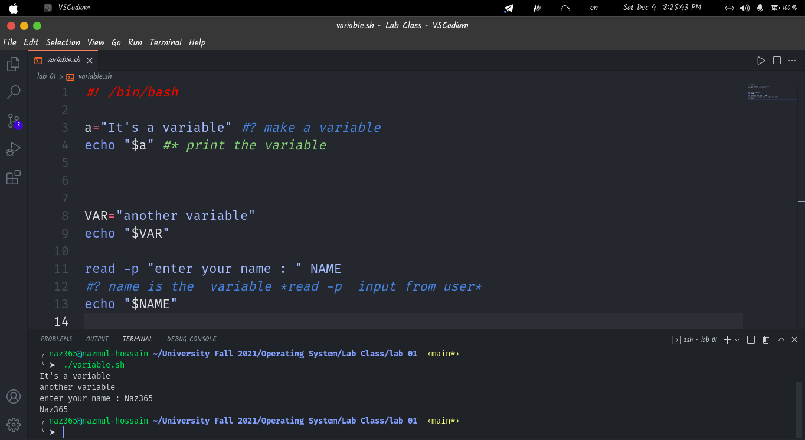

Slide 13
Thanks; {
THank you
Stay with us
“Do you have any questions?”
Mohammad Nazmul Hossain nazmul.gub.cse@gmail.com
+880 155 33 41 33 8
}
Bash Programming Language

